Slide 1


Iot Anwendungsprojekt
@ HHZ Living Lab
Wahlfach IoT Prof. Dr.-Ing Christian Decker
SoSe 2018
Fridge
-
fitting
Alisa Bunte, Caroline Pohl, Georgios Kaza, Rabia Karatas, Selina Klingler

Slide 2
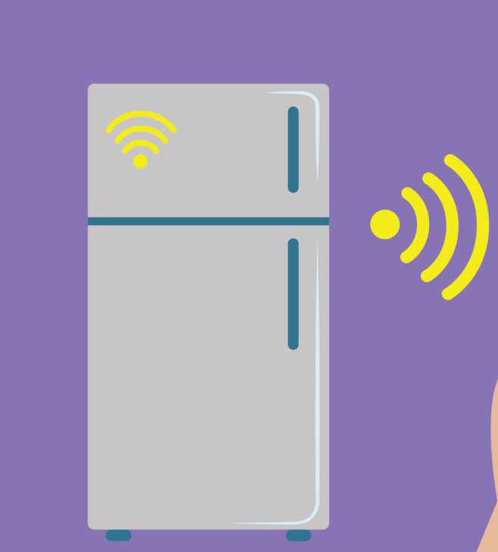




Task
Fridge
-
fitting
Smart Fridge
Zu teuer
15.06.2018
2

Slide 3
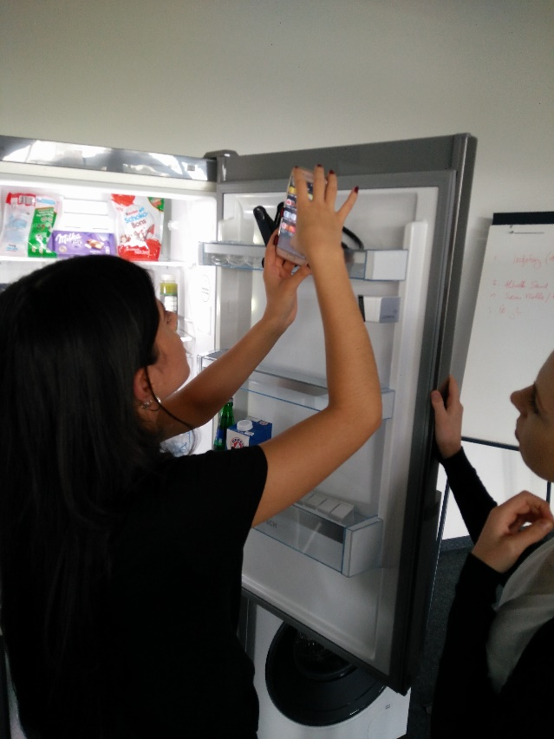
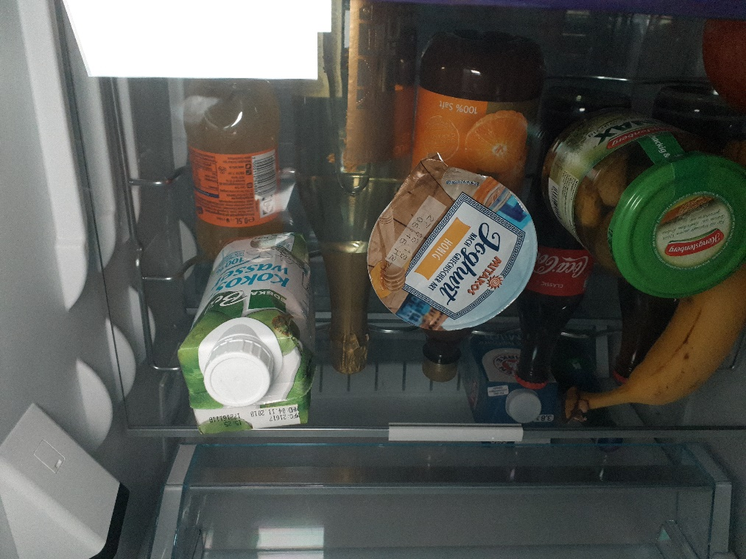
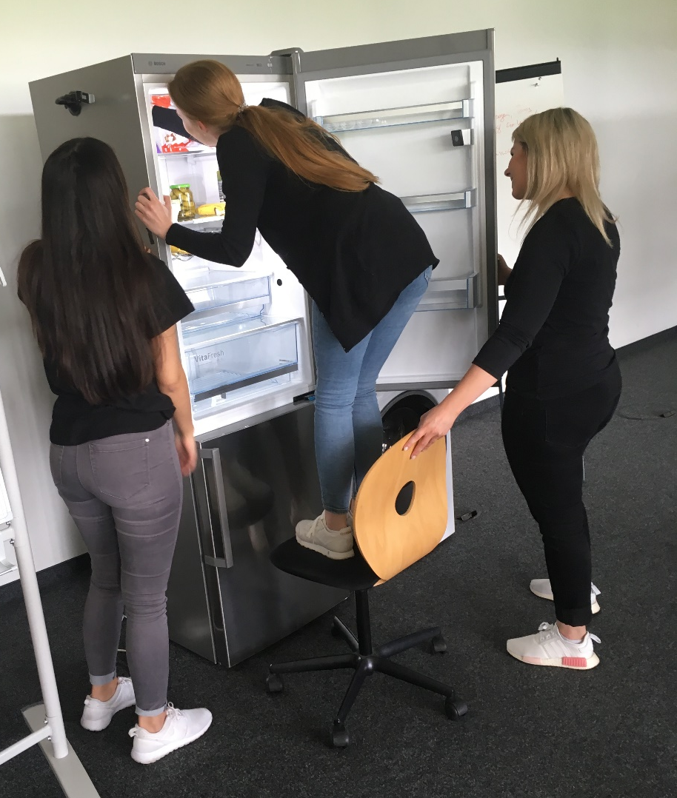
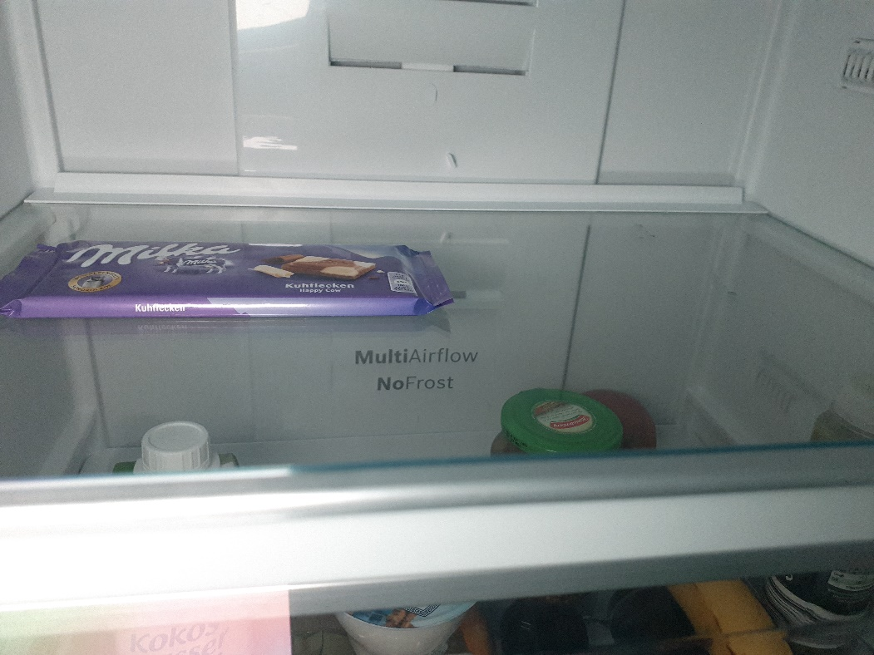
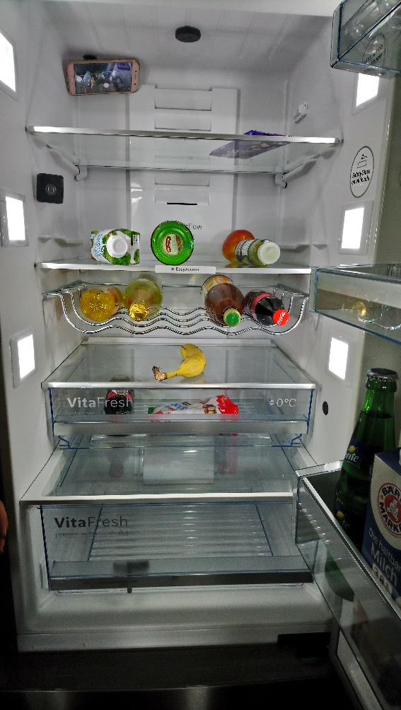
Hackathon
Fridge
-
fitting
15.06.2018
3

Slide 4
evaluation
Fridge
-
fitting
total
critical
identification
registration
Fridge position
15.06.2018
4

Slide 5
Thank you!
Fridge
-
fitting
Alisa Bunte, Caroline Pohl, Georgios Kaza, Rabia Karatas, Selina Klingler

